Slide 1

Capstone Project Development Gantt Chart
By: Eunice B. Custodio, PhD., DIT

Slide 2
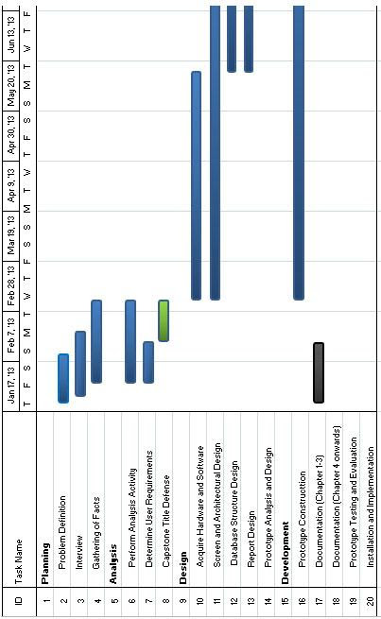
Capstone Project development Roadmap/Timeline/Milestone Gantt Chart (CP1)

Slide 3
Other Activities/Deliverables
Submission of Chapters 1-3
Pre-oral defense/Final Defense
Revision of the documents/manuscripts & Software
Revision of the Prototype and architectural design/diagrams
Submission of the Revised Manuscripts
Submission of the Final Hardbound/CD (IMRaD-conference paper)

Slide 4
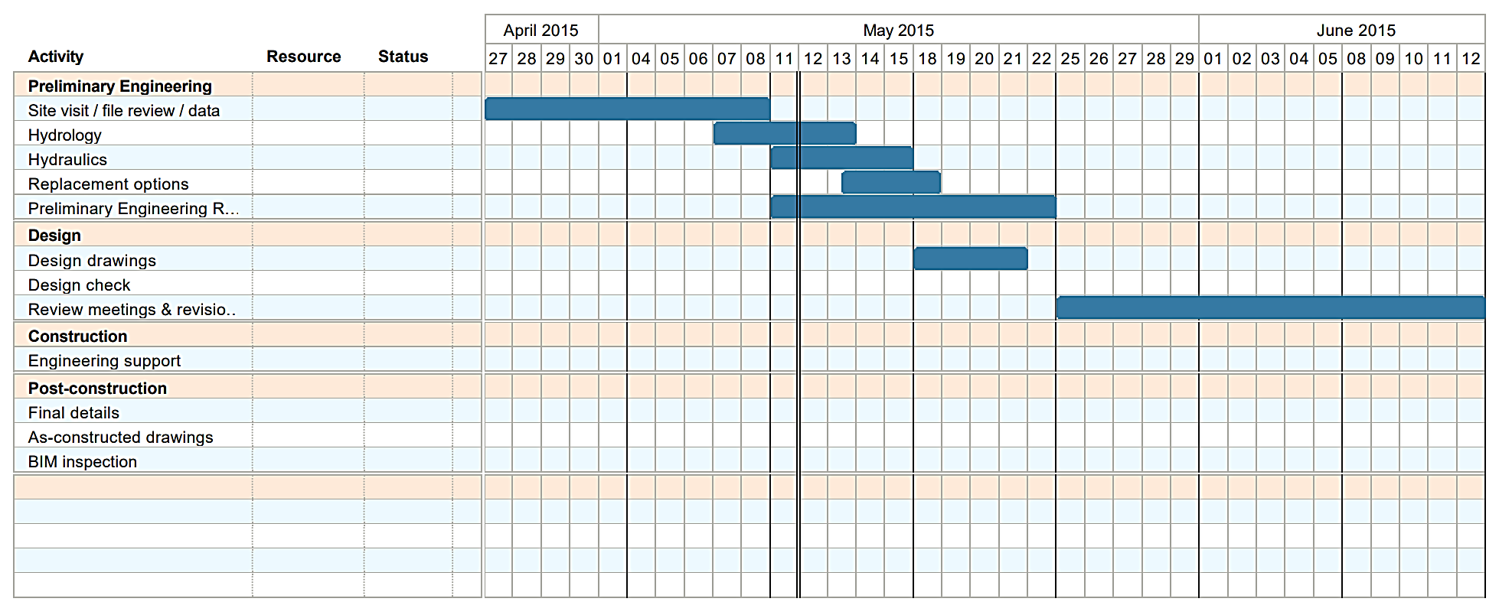
Product Roadmap Gantt Chart

Slide 5
